Slide 1
Strategic recommendation
ENIAC and MAGIST

Slide 2
Goals
Expand our business to Brazil until 2023
Shortterm goal: find a local partner in Brazil to support our
business expandation
Midterm goal: take over the Brazilian market

Slide 3
Should we invest in MAGIST?
Is MAGIST a good fit for high-end tech products?
Are orders at MAGIST being delivered on time?

Slide 4
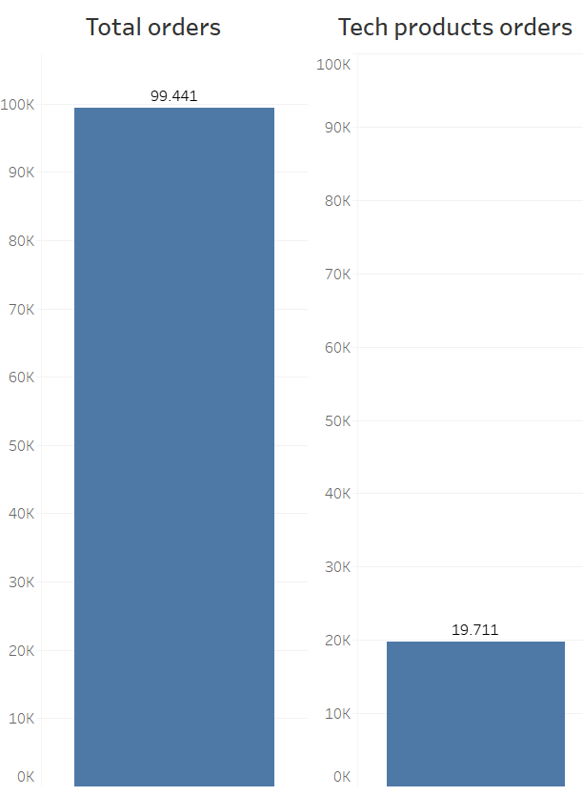
Is MAGIST a good fit for high-end tech products?

Slide 5
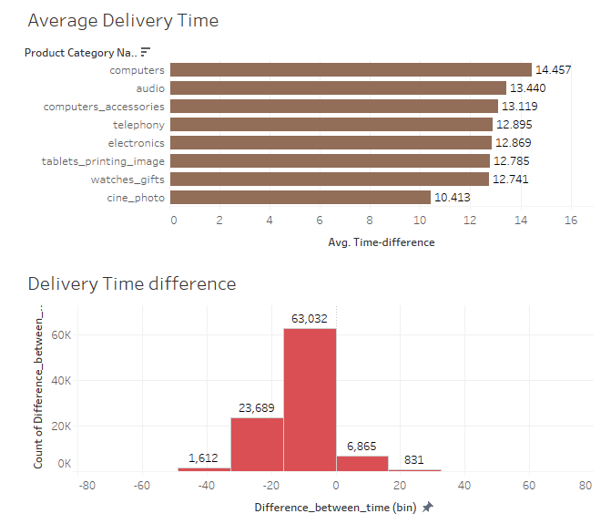
Are orders at MAGIST being delivered on time?

Slide 6
Final conclusion
Average monthly income of tech-product sellers on MAGIST is 30% higher than the average monthly income of all sellers
MAGIST has great experience in delivering products all over Brazil due to a wide network
MAGIST‘s customers are highly satisfied with their performance (avg of 4.08 out of 5 stars)
ENIAC products will fit perfectly into the MAGIST catalogue
ENIAC should invest in MAGIST

